Slide 1
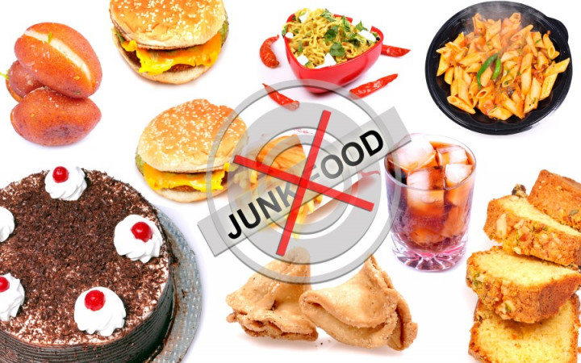
JUNK FOOD

Slide 2
What is junk food?
'Junk foods' are foods that lack nutrients, vitamins and minerals, and are high in kilojoules (energy), salts, sugars, or fats. Junk food is so called because it doesn't play a role in healthy eating, especially if you eat too much of it. Junk food is also known as 'discretionary food' or 'optional food'.
Some examples of junk food include:
cakes and biscuits
fast foods (such as hot chips, burgers and pizzas)
chocolate and sweets
processed meat (such as bacon)
snacks (such as chips)
sugary drinks (such as sports, energy and soft drinks)
alcoholic drinks
If your diet is high in fats, salt and sugar and you are not receiving essential nutrients, your risk of obesity and other chronic (long-term) diseases may increase.

Slide 3
How do I know if a food product is 'junk food'?
While finding healthy alternatives to junk food can sometimes be difficult, the Health Star Rating system is a convenient tool to help you know how healthy a product is. It's a quick and easy way to compare similar packaged foods.
The Health Star Rating system rates packaged foods between half a star and 5 stars, based on how healthy they are. These ratings are found on the front of packaged items. However, it is important to note that this system is very general, and the nutritional value of some products may not be accurately expressed by the rating they receive.
Remember also that the Health Star Rating system is designed only for packaged products sold in shops, so it won't include some healthy foods — including fresh unpackaged food such as fruit and vegetables.

Slide 4
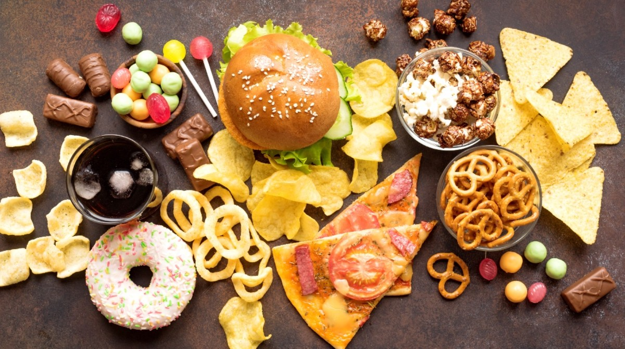
How do I make healthy food choices?
It's important to understand the nutritional value of the food you are buying. You can do this by reading the nutrition panel found on the back of all packaged items in Australia.
Food labels can tell you things like the amount of energy, protein, fat, carbohydrates, sugars, fibre and sodium (salt) in each product, as well as the recommended serving size.

Slide 5
Understanding health claims
When checking a product for its nutritional value, make sure you look at the health claims such as 'low in fat' or 'sugar free', as these can be misleading. When a product is advertised as 'light' or 'lite', this may refer only to the product's colour or flavour. This means that the product may still be 'full-fat' — be sure to read the nutrition information panel at the back of the package for the actual fat content.
Another common claim is that a product is 'sugar-free' or has 'no added sugar'. In truth, this means that a product has no added sucrose or table sugar, but it may still contain other types of sugar. The product may also contain salt or fat and may be high in kilojoules, so even sugar free products can be junk foods.
Note also that products known as 'health foods' such as some fruit juices and muesli bars can actually be junk food if they contain high levels of sugar, salt or fat. Check a product's Health Star Rating for a better guide to how healthy the product is. Keep in mind that this rating system is limited in accuracy, but may be a better guide than advertised claims.

Slide 6
Can I include a small amount of junk food in a healthy diet?
Yes, in line with the Australian Dietary Guidelines, a small amount of junk or discretionary food can be included in a healthy, balanced diet. This means you should only have junk food occasionally and in small amounts. In general, most Australians eat too much junk food and should work on eating less of it, less often.
It is important to balance your junk food intake with increased exercise to help burn off extra energy. This will help you avoid gaining excessive weight.
When thinking about how much junk food you eat, remember that everybody is different — if you are shorter or smaller than average, or you do less exercise than the average person, you will also need to eat less than the average person. If you are trying to lose weight, try and keep the amount of junk food you eat to a minimum.

Slide 7
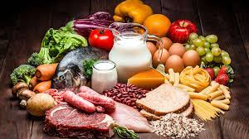
What is Healthy Food?
Healthy food is food that is nutrient-dense and contributes to a healthy body. It is typically low in calories, high in fiber, and contains essential vitamins and minerals that the body needs to function properly. Examples of healthy foods include fruits, vegetables, whole grains, lean proteins, and healthy fats.

Slide 8
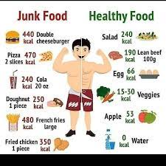
JUNK FOOD VS HEALTHY FOOD

